Slide 1

Toward phylodynamic inference from Typewriter lineage recordings
Antoine Zwaans & Sophie Seidel
09/09/2022
Sophie Seidel
30 June 2021, ISMB/ECCB
Notes:
Hello & thank you for joining
Present a framework to estimate
-> use single cell lineage tracing & rna seq data
→ to infer
1

Slide 2

Cellular processes during development
scRNA seq data gives us frequency of cell types
Lacks to inform the cell dynamics leading to these cell type frequencies
Notes:
There are still a lot of unknowns about the decision that cells take as they develop into a tissue or an organism – and how these decisions differ in diseased tissues.
If you think about it, if a cell divides it always leaves two offspring. And so the process of development can be thought of as a phylogenetic trees of cells along which cell state transitions happen. So questions about the developmental process are phylogenetic in nature.
In my PhD, I develop phylogenetic tools to learn about decisions that cells make during development. I am interested in the cellular dynamics: , e.g.
which cell type created the most of the cell mass in a tissue? What cell types can be created by another type? And when do cells comit to a certain type?
If we think about development on a cellular level, as cells progress from the zygote stage to a fully grown organism, there are 3 types of events
studies combining
scRNAseq + lineage tracing
abundance of cell types at t + what process gives rise to this abundance
For a single organism it is interesting
→ what process gives rise to this abundance
lineage tracing
– labels cells with evolving barcodes
basic idea: starting cell has unedited barcode, in time window CRISPR editing is inflicted, later timepoint cells are sampled
allows reconstruct the lineage hierarchy given the barcodes
scRNAseq
-> cell type composition at a single time point
from the lineage perspective – because we can explicitly capture cell division & death dynamics as well as the cell type changes
2

Slide 3
Aim
Use signal from joint lineage & scRNA measurements to quantify core developmental processes
i.e. division, apoptosis, differentiation
Notes:
There are still a lot of unknowns about the decision that cells take as they develop into a tissue or an organism – and how these decisions differ in diseased tissues.
If you think about it, if a cell divides it always leaves two offspring. And so the process of development can be thought of as a phylogenetic trees of cells along which cell state transitions happen. So questions about the developmental process are phylogenetic in nature.
In my PhD, I develop phylogenetic tools to learn about decisions that cells make during development. I am interested in the cellular dynamics: , e.g.
which cell type created the most of the cell mass in a tissue? What cell types can be created by another type? And when do cells comit to a certain type?
If we think about development on a cellular level, as cells progress from the zygote stage to a fully grown organism, there are 3 types of events
studies combining
scRNAseq + lineage tracing
abundance of cell types at t + what process gives rise to this abundance
For a single organism it is interesting
→ what process gives rise to this abundance
lineage tracing
– labels cells with evolving barcodes
basic idea: starting cell has unedited barcode, in time window CRISPR editing is inflicted, later timepoint cells are sampled
allows reconstruct the lineage hierarchy given the barcodes
scRNAseq
-> cell type composition at a single time point
from the lineage perspective – because we can explicitly capture cell division & death dynamics as well as the cell type changes
3

Slide 4
Outline
Phylodynamic inference
Typewriter
Features of the editing process
Modelling the editing process
Simulations under the model

Slide 5
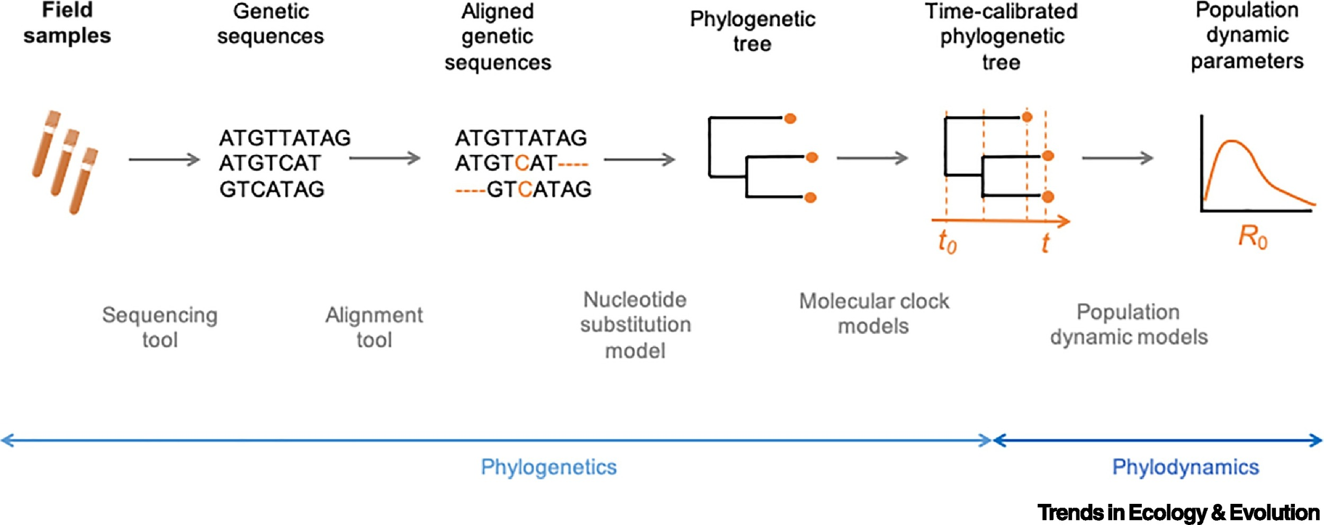
General workflow in phylodynamics

Slide 6
General workflow in phylodynamics
Develop substitution model for TypeWriter editing process

Slide 7
Outline
Phylodynamic inference
Typewriter
Features of the editing process
Model and likelihood calculation of the editing process

Slide 8
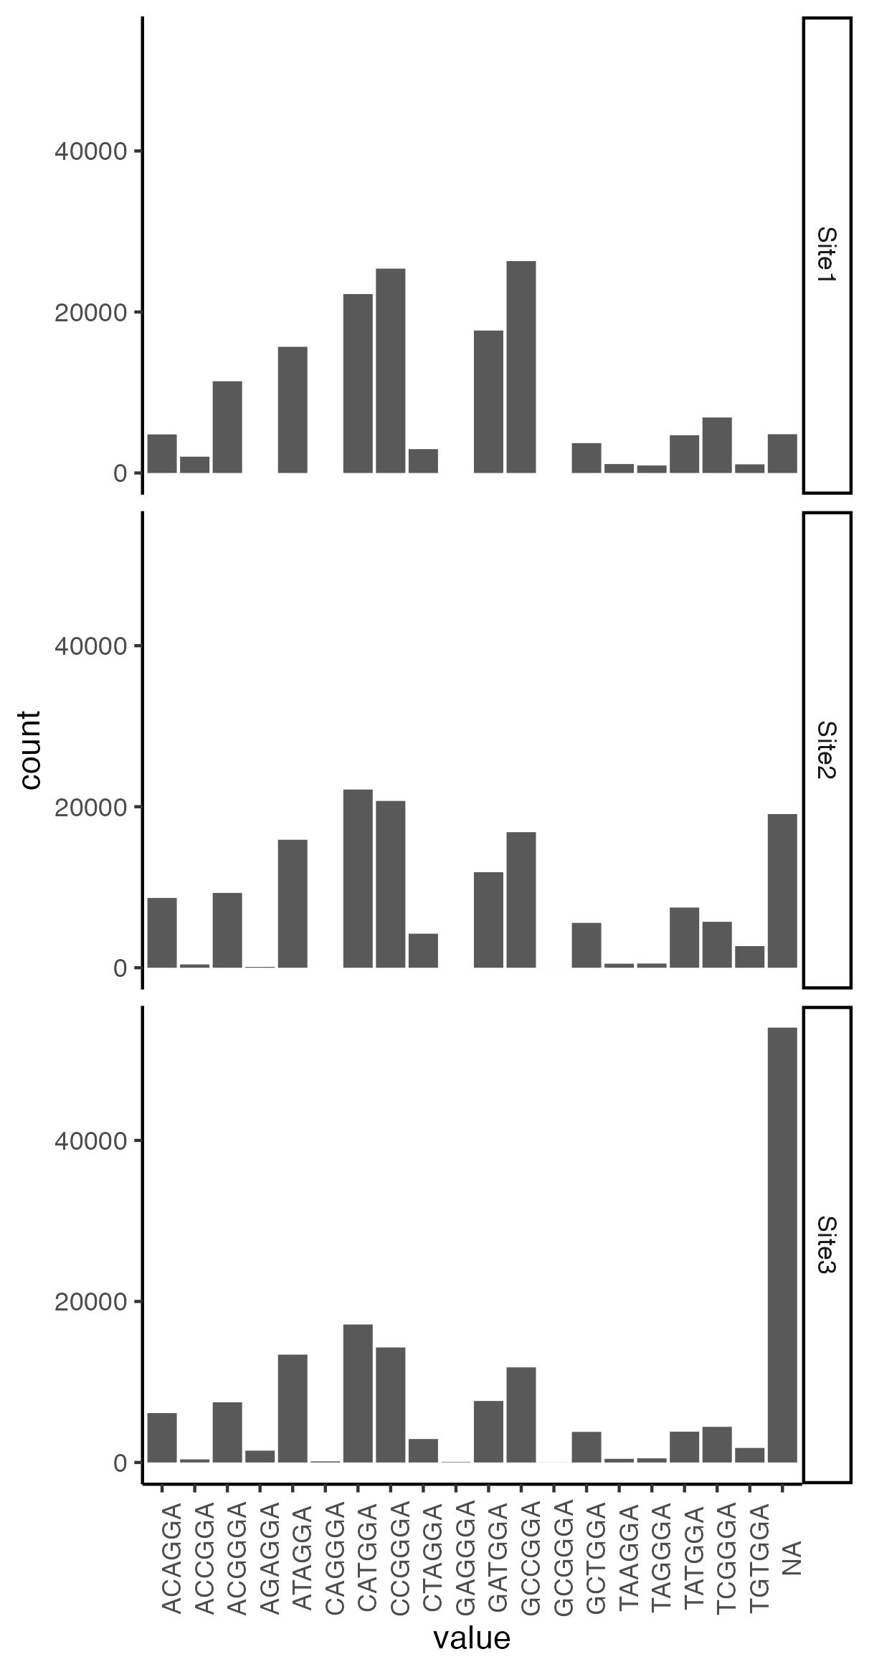
Typewriter data – insert distributions
Inserts sequences all are not equally likely to be edited in.
Insert distributions seem to be consistent over different sites.
Preferential insertion of: CAT CCG ATA GCC

Slide 9
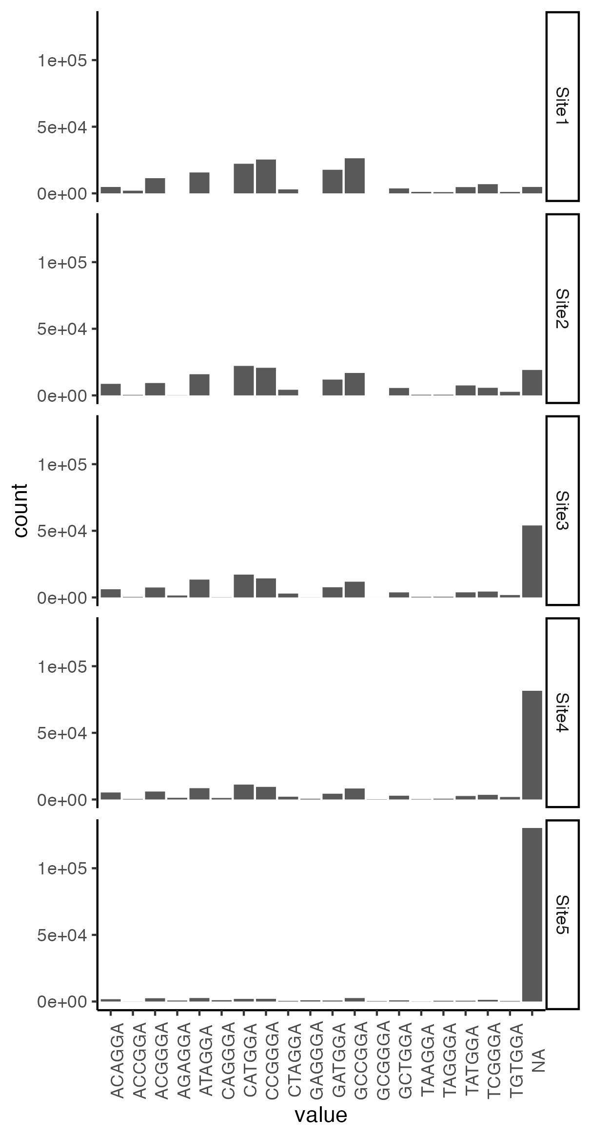
Typewriter data – insert distributions

Slide 10
Typewriter data – insert distributions

Slide 11
Lineage tracing data – insert distributions

Slide 12
Lineage tracing data – insert distributions

Slide 13
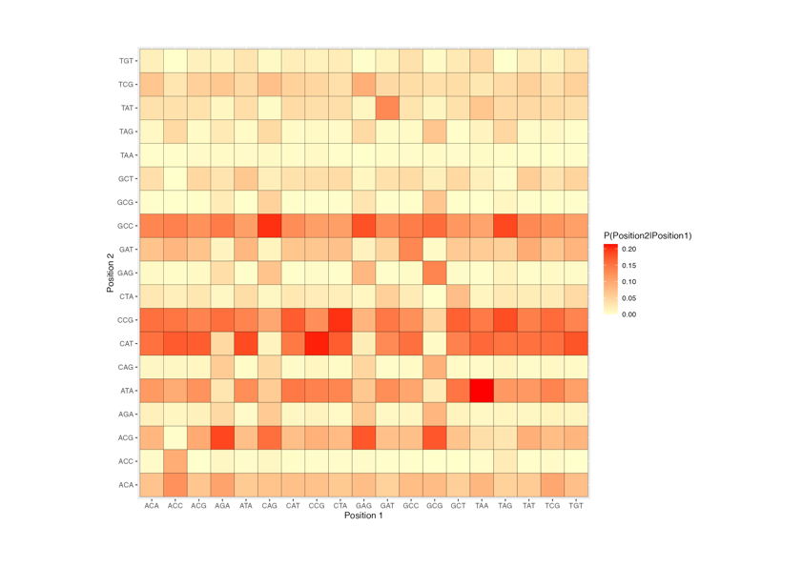
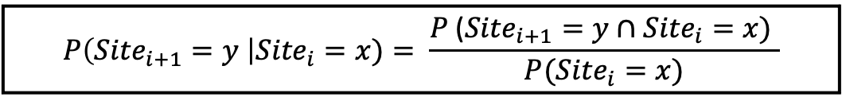
Typewriter data – insert distributions
The probability of editing in an insert is mostly not conditional on which insert is edited into the previous site.
Are there patterns conditional on non-adjacent sites?
$$P\left({Site}_{i+1}=y \right|{Site}_{i}=x)= \frac{P \text{(}{Site}_{i+1}=y∩{Site}_{i}=x) }{P({Site}_{i}=x)}$$

Slide 14
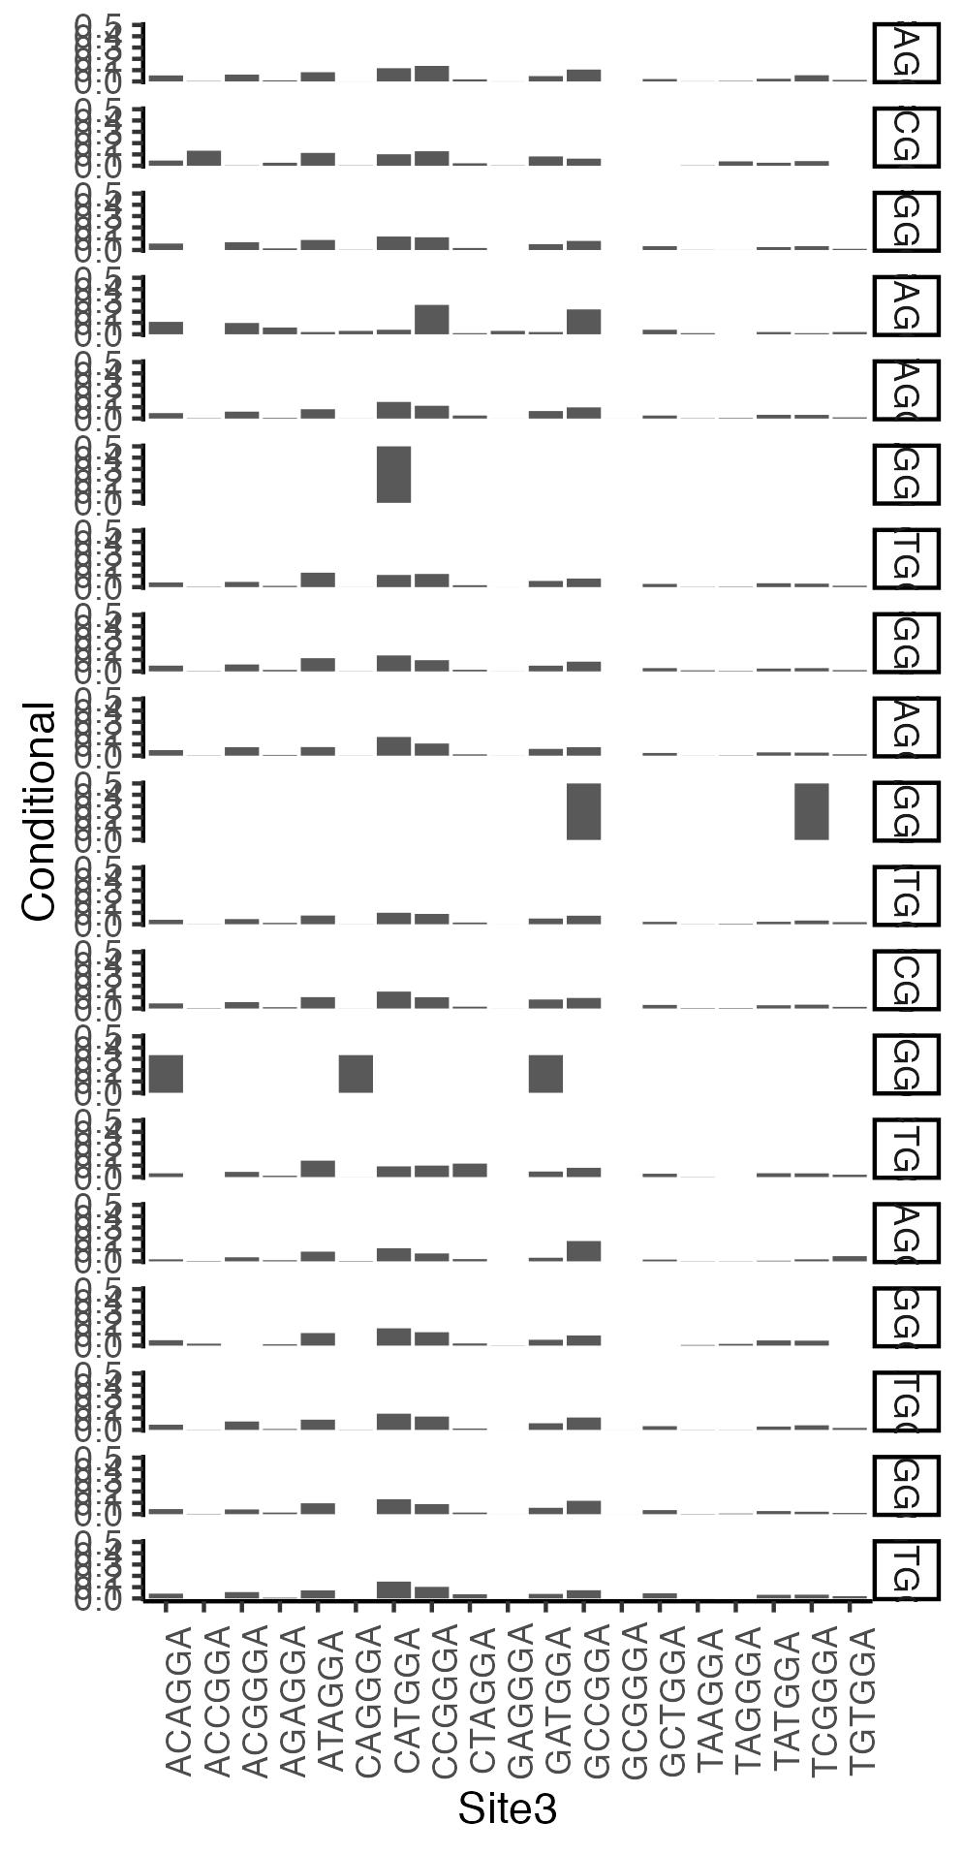
Lineage tracing data – insert distributions
Prob edit 3 given 2

Slide 15
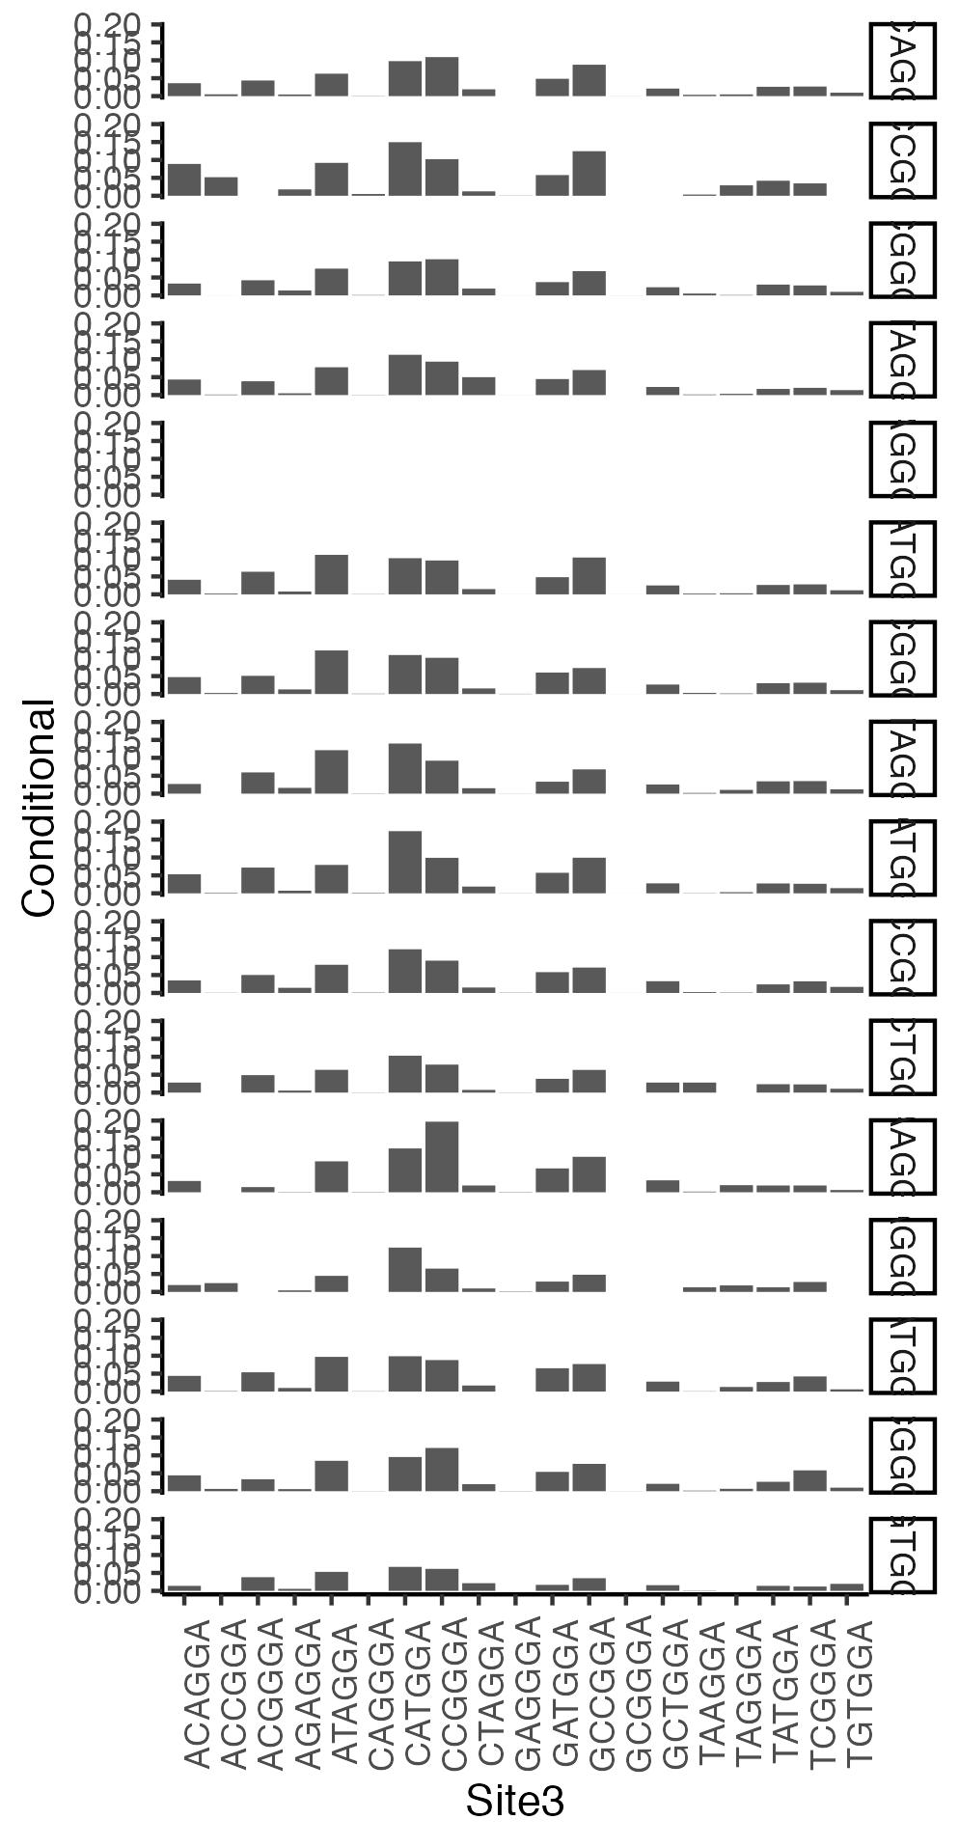
Lineage tracing data – insert distributions
Prob edit 3 given 1

Slide 16
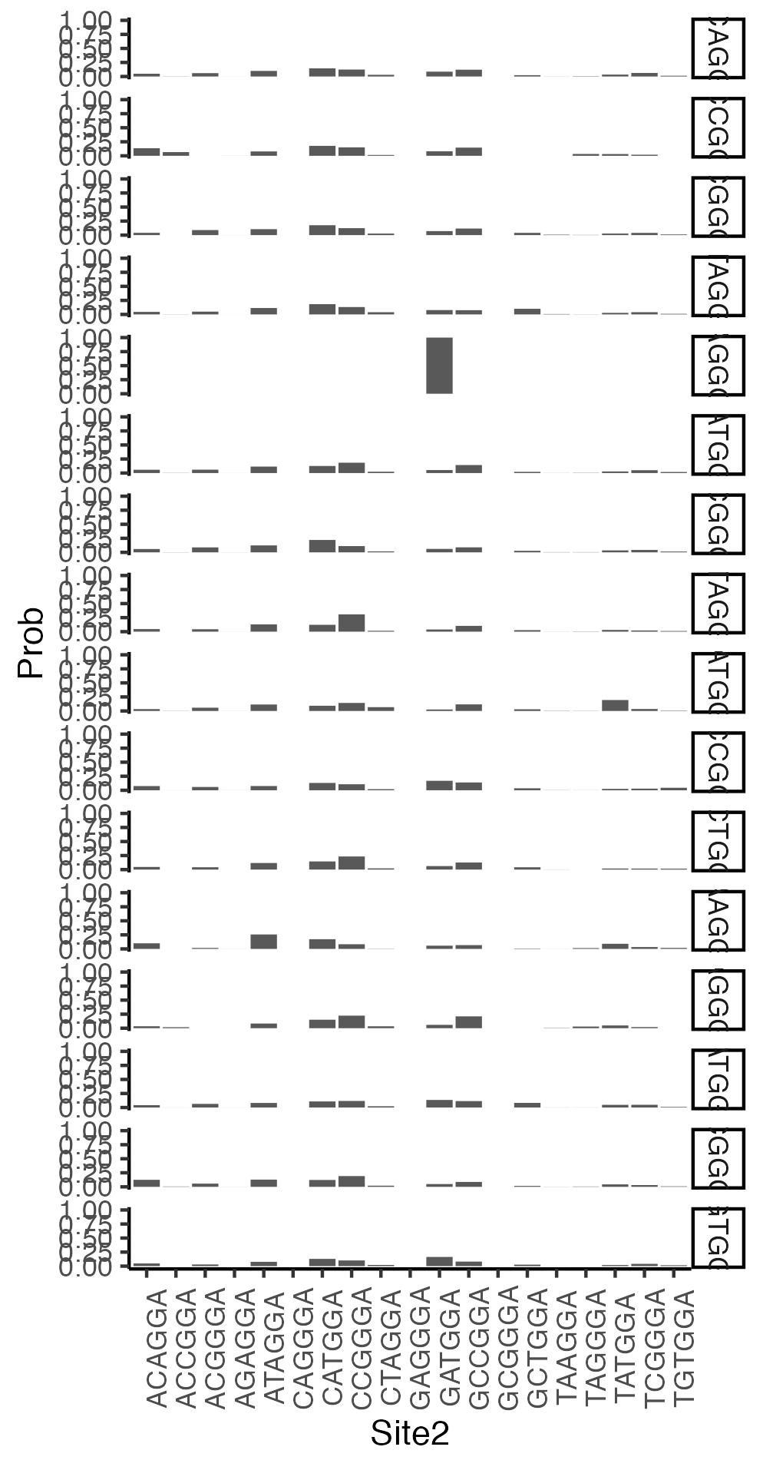
Lineage tracing data – insert distributions
Prob edit 2 given 1

Slide 17
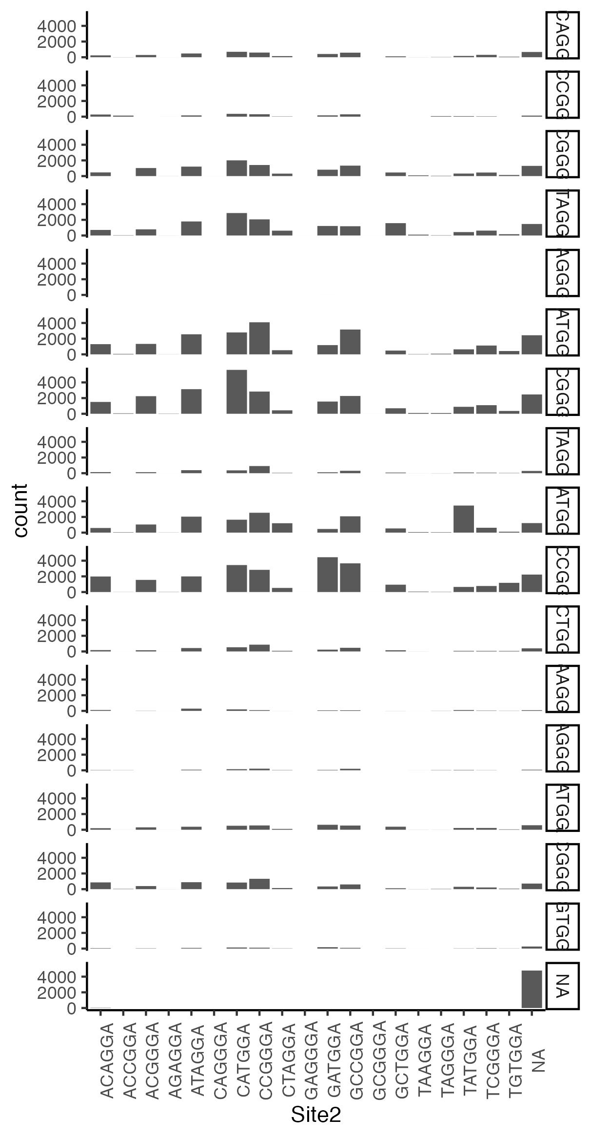
Lineage tracing data – insert distributions
Conditional edit 2 1

Slide 18
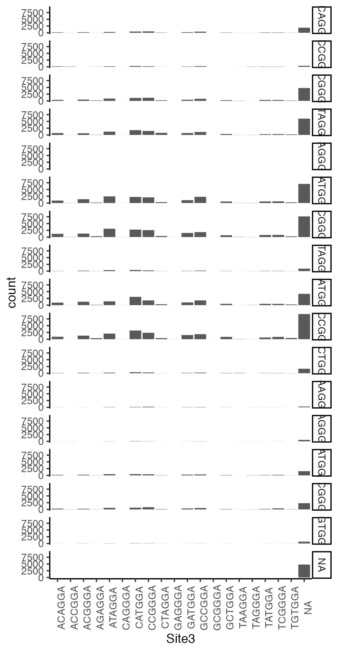
Lineage tracing data – insert distributions
Conditional edit 3 1

Slide 19

Clock model – editing speed
What are the editing dynamics over time?
Can we assume a constant editing rate?

Slide 20
Clock model – editing speed
What are the editing dynamics over time?
Can we assume a constant editing rate?
How can we approximate this rate?

Slide 21
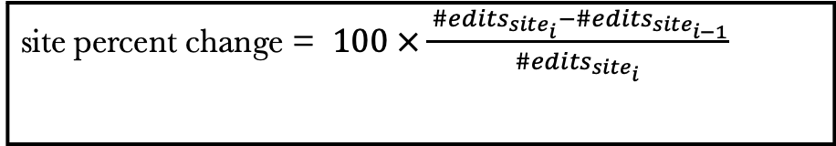
Clock model – editing speed
What are the editing dynamics over time?
Can we assume a constant editing rate?
9.71
26.33
28.18
69.34
site percent change = $100 ×\frac{ {\#edits}_{{site}_{i}}−{\#edits}_{{site}_{i−1}}}{{\#edits}_{{site}_{i}}}$

Slide 22

Clock model – editing speed
What are the editing dynamics over time?
Can we assume a constant editing rate?
Conditional editing rates seem to decrease over time
9.71
26.33
28.18
69.34
site percent change = $100 ×\frac{ {\#edits}_{{site}_{i}}−{\#edits}_{{site}_{i−1}}}{{\#edits}_{{site}_{i}}}$

Slide 23
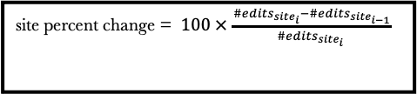
Clock model – editing speed
1000 bootstrap samples of the percent change.
Conditional editing rates decrease over time, with sites 2 to 4 closest.
site percent change = $100 ×\frac{ {\#edits}_{{site}_{i}}−{\#edits}_{{site}_{i−1}}}{{\#edits}_{{site}_{i}}}$

Slide 24
Clock model – editing speed
rate of introducing any edit
constant or vary across sites
could vary through time

Slide 25
Mutation model -
rate scalers of adding a particular insertion
depend on the insertion outcome (colour) – weigh the frequency
do not depend on insertion at current site

Slide 26
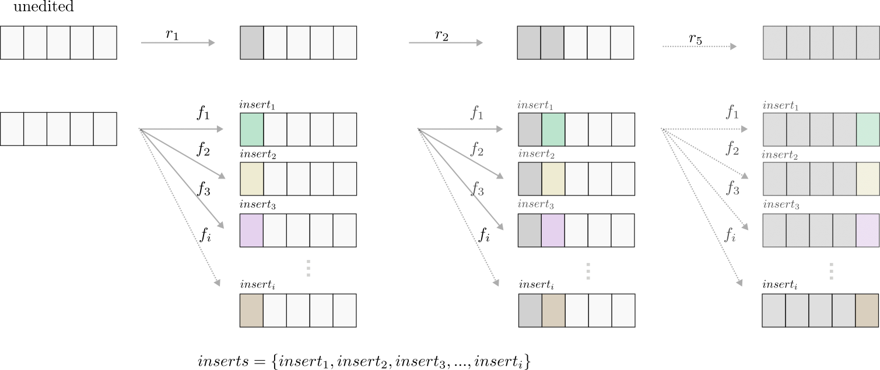
Mutation model

Slide 27
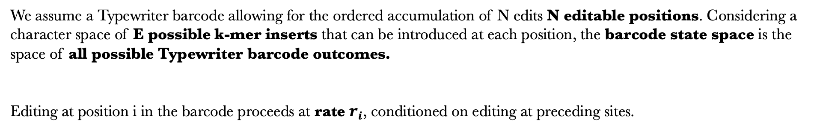
Mutation model
We assume a Typewriter barcode allowing for the ordered accumulation of N edits N editable positions. Considering a character space of E possible k-mer inserts that can be introduced at each position, the barcode state space is the space of all possible Typewriter barcode outcomes.
Editing at position i in the barcode proceeds at rate $r_{i}$, conditioned on editing at preceding sites.

Slide 28
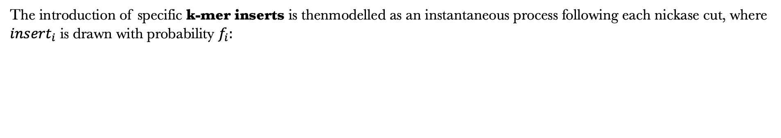
Mutation model
The introduction of specific k-mer inserts is thenmodelled as an instantaneous process following each nickase cut, where ${insert}_{i}$ is drawn with probability $f_{i}:$

Slide 29
Simulations under the model
Question: How are the total edits distributed under a constant molecular clock assumption?
Setup:
Simulate 2 birth-death scenarios:
500 cells
Growth “burst” towards the present
Past branching
Simulate 13 barcodes along these trees

Slide 30
Simulations under the model
Question: How are the total edits distributed under a constant molecular clock rate assumption?
Setup:
Simulate 2 birth-death scenarios:
500 cells
Growth “burst” towards the present
Past branching
Simulate 13 barcodes along these trees

Slide 31
Simulations under the mutation model
Conclusions:
Total edit distributions are dependent on underlying tree shape
We expect Poisson distributed edits with constant growth rate + constant edit rate.

Slide 32
Simulations under the model
Setup:
Simulate tree with 3257 cells
Constant growth
Time scale 25 days
Simulate 13 barcodes

Slide 33
Simulations under the model
Setup:
Simulate tree with 3257 cells
Constant growth
Time scale 25 days
Simulate 13 barcodes

Slide 34
Data generation – population tree
model cell population growth with a birth-death model

Slide 35
Data generation – sampled tree
model cell population growth with a birth-death model with sampling, i.e.
only subset of cells is sequenced

Slide 36
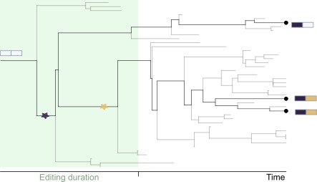
Data generation – sequence data
model sequence evolution along the tree under the editing model

Slide 37
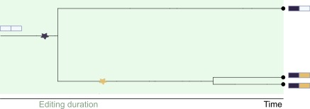
Inference of cell tree
True tree
we know the sequence of events
we don’t know: timing and frequency

Slide 38
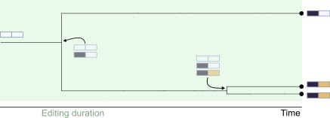
Inference of cell tree
True tree
Possible sequence of events

Slide 39
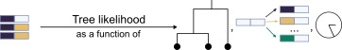
Inference of cell tree
True tree
Possible sequence of events

Slide 40
Questions / Discussion
Ideas on editing process
more replicates of the cell culture data (i.e. as in type writer manuscript) available?

